Slide 1
Using Python to Analyze the Surface Activity of Cobalt Catalysts for Oxygen Evolution Reaction
Poppy Mak
CME 502
Professor Nav Nidhi Rajput
Huang, J., Borca, C.N., Huthwelker, T. et al. Surface oxidation/spin state determines oxygen evolution reaction activity of cobalt-based catalysts in acidic environment. Nat Commun 15, 3067 (2024). https://doi.org/10.1038/s41467-024-47409-y

Slide 2
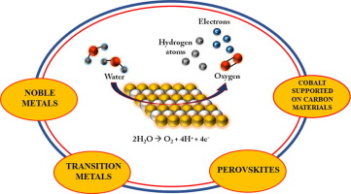
Oxygen Evolution Reaction (OER)
Limiting reaction in the process of generating molecular oxygen through a chemical reaction
A critical semi-reaction that severely limits the occurrence of water splitting due to the slow kinetics of four-electron transfer
Cobalt-based materials are the well-stocked conductive catalytic feedstock, which can lower the energy cost needed by lowering the overpotential
Afreenuzzaman Badruzzaman, Afdhal Yuda, Anchu Ashok, Anand Kumar, Recent advances in cobalt based heterogeneous catalysts for oxygen evolution reaction, Inorganica Chimica Acta, Volume 511, 2020, 119854, ISSN 0020-1693, https://doi.org/10.1016/j.ica.2020.119854.

Slide 3
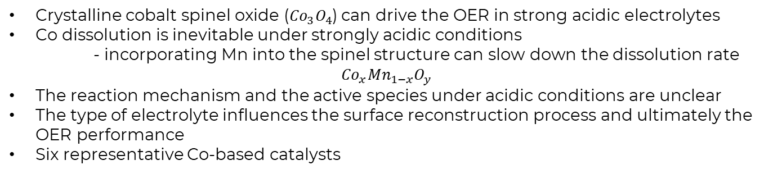


Cobalt-Based Catalysts
Crystalline cobalt spinel oxide (${Co}_{3}O_{4}$) can drive the OER in strong acidic electrolytes
Co dissolution is inevitable under strongly acidic conditions
- incorporating Mn into the spinel structure can slow down the dissolution rate
$${Co}_{x}{Mn}_{1−x}O_{y}$$
The reaction mechanism and the active species under acidic conditions are unclear
The type of electrolyte influences the surface reconstruction process and ultimately the OER performance
Six representative Co-based catalysts
With surface ${Co}^{III}$ species
- commercial ${Co}_{3}O_{4}$
- ${FeCo}_{2}O_{4}$
- reconstructed $CoO$
Without surface ${Co}^{III}$ species
- commercial ${Co(OH)}_{2}$
- ${CoCr}_{2}O_{4}$
- co-doped ${CeO}_{2}$
Notes:
2. The extent can be decreased using proper catalyst engineering
Mn Manganese

Slide 4
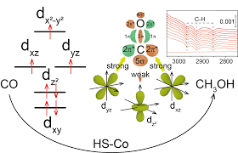
The Goal
Reveal a structure-activity relationship between the OER activity of Co-based samples in an acidic environment and the Co oxidation/spin state
Overall oxidation state and spin state of Co depend on the fraction of Co in the structure
Show the differences between the catalytic activity in basic and acidic conditions
If Co is assumed to be the predominant active center for OER catalysis, the catalytic activity should increase with increasing Co content

Slide 5
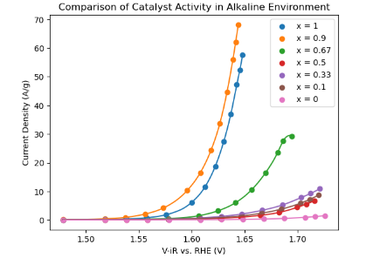

Approach
Notes:
Comparing catalyst activity in alkaline and acidic environments
Generally the OER current decreases with x in an alkaline environment, which supports the widely reported hypothesis that Co is the predominant active center for the OER

Slide 6
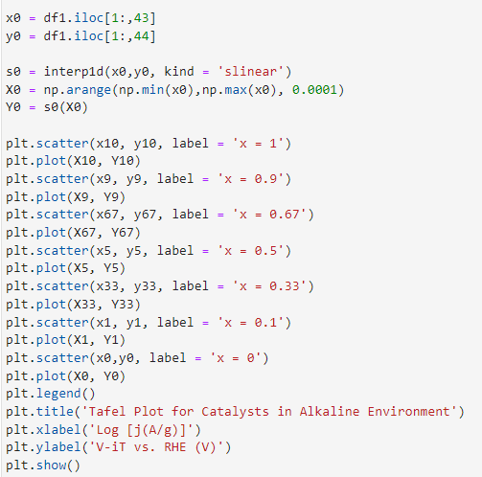
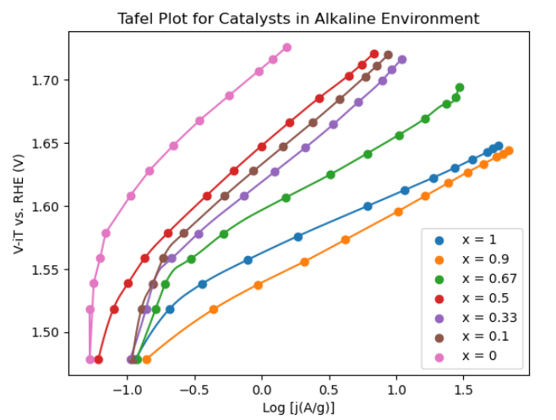
Notes:
This is a tafel plot for the catalysts in an alkaline environment
The tafel slope is a parameter used to analyze the kinetics of electrochemical reactions, with a higher tafel slop indicating a slower reaction rate
The tafel slope increased from -50 to -90 mV/dec with decreasing x

Slide 7
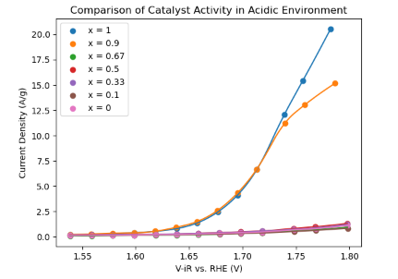
Notes:
Comparison of catalyst activity in an acidic environment
There is a very sharp decrease for the samples with x less than 0.9
Both samples with x = 0.1 and 0.9 are active in the alkaline and acidic environments
This means that the surface area exposed to the electrolyte is not likely to be a major factor in determining the catalytic activity of Co(x)Mn(1-x)O(y) in an acidic electrolyte

Slide 8
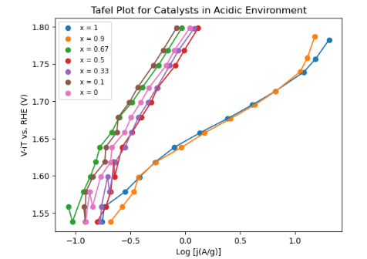
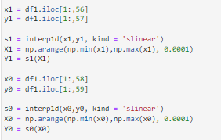
Notes:
Tafel slop for catalyst in acidic environment
Tafel slope for each sample has a higher value than in the basic electrolyte

Slide 9
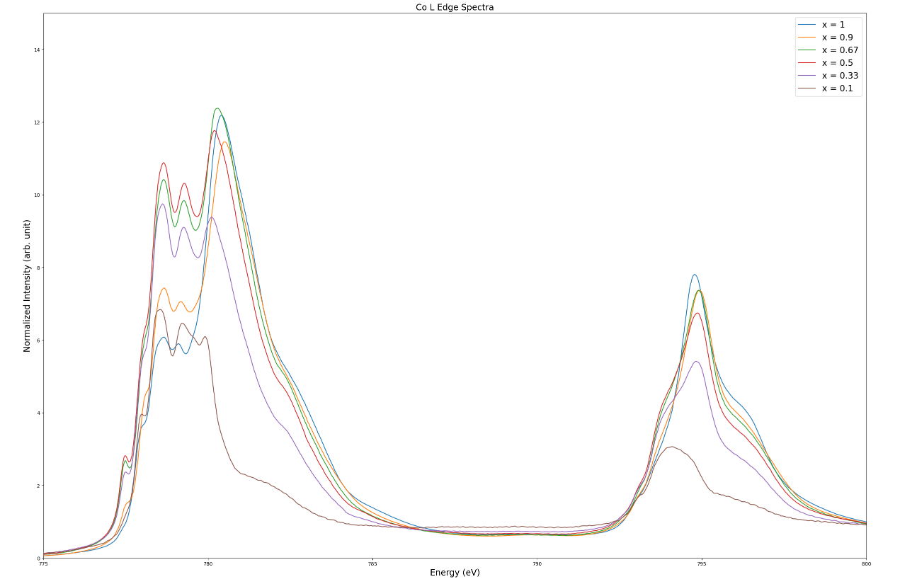
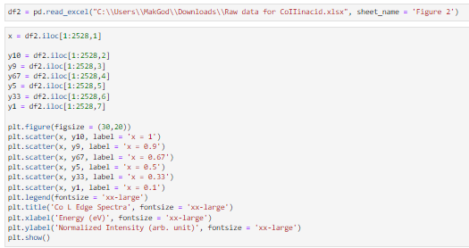




$${Co}^{II}$$
$${Co}^{III}$$
$$Co L_{3}$$
$$Co L_{2}$$
Notes:
Correlation of surface state of the catalysts with OER activity in acidic environments
L3 and L2 edges show differences in their spectral shape
Co L3 has the greatest intensity with lower energy
While Co L2 has lower intensity with higher energy
Show that the Co spin state shifts from low spin to high spin with decreasing Co content in the catalyst
The OER in acidic environment is directly controlled by the surface Co oxidation state
Co spin state also seems to correlate with the Co oxidation state in the catalyst
These results suggest that the surface dominated by high spin Co II is not active towards the OER in an acidic environment because the Co oxidation to promote surface reconstruction is unfavorable

Slide 10
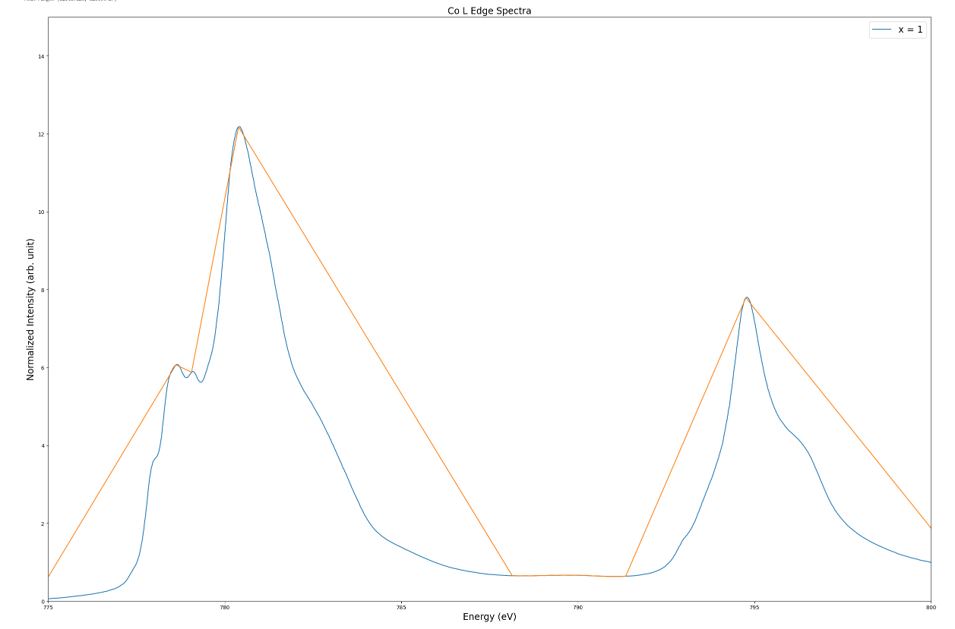
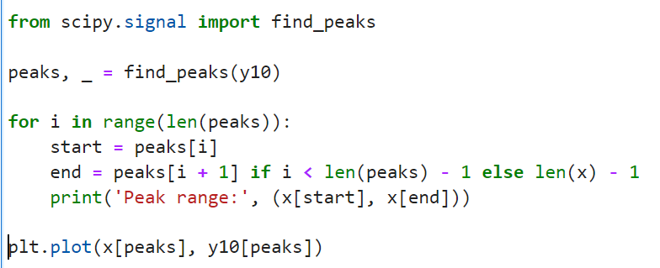
Isolate the Peak Values
Notes:
Right now, when this part of the code is run, there are about a couple hundred ranges that are outputted, so I will try to find a way to condense those into hopefully just a handful of points that represent the main peaks of each plot

Slide 11
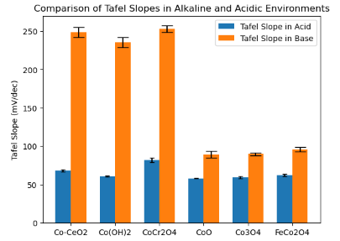
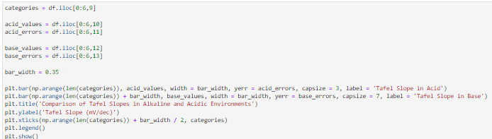
Notes:
The lower tafel slopes associated with the acidic environment indicate a faster reaction rate and better catalytic activity. In this context of OER, a lower tafel slope suggests that the catalyst is more effective.
Low tafel slopes are due to catalysts with low spin, which would be Co III while higher tafel slopes are associated with high spin Co II
Low spin: involve more efficient charge transfer processes, leading to faster reaction kinetics and lower overpotentials
High spin: slower charge transfer kinetics, resulting in higher overpotentials and less efficient catalytic activity

Slide 12
Conclusions
Allow analysis to become more efficient by removing the need to isolate data by hand
Surface state is more critical in determining the final OER activity, highlighting the importance of surface engineering
Future Work:
Create a user interface that allows the input of data as it is collected
Notes:
Since the co oxidation to promote the surface reconstruction is unfavorable
The presence of low spin CoIII and the ability to reconstruct into active Co species are important to initiate the OER in an acidic environment

